Slide 1

Software Architecture
Lecturer
Rokas Slaboševičius
Data

Slide 2
Today you will learn
Lecture title
N-Tier Architecture
DDD - Domain-driven design
01
03
Clean Architecture
DRY - Don't repeat yourself
02
03

Slide 3
What is Software Architecture?
Async/await
Asynchronous programming
Software architecture refers to the high-level structuring of a software system. It‘s blueprint for a building. Just as architects design buildings, software architects design the structure of software systems. This design includes decisions about how to divide the system into parts and how these parts interact with each other.

Slide 4
N-Tier Architecture
Async/await
Asynchronous programming
N-Tier Architecture is a software design pattern that organizes applications into separate, logical layers. Each layer has a specific responsibility and operates independently. This separation enhances scalability, maintainability, and manageability of the application.
Presentation Layer: The user interface. It handles user interactions and displays data.
Business Logic Layer: The core processing layer. It controls application functionality by performing calculations, making decisions, and processing data.
Data Access Layer: Manages data persistence and retrieval. It communicates with databases or other storage systems.

Slide 5
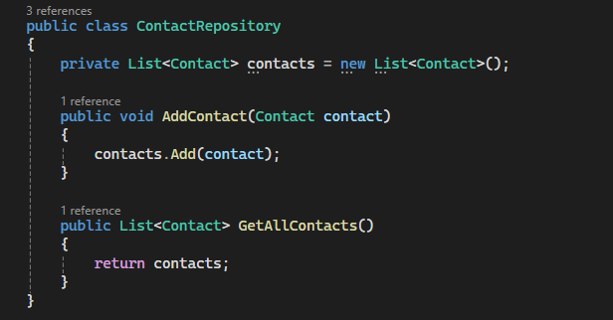
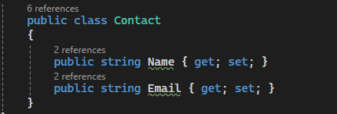
Data Access Layer (DAL)
Async/await
Asynchronous programming

Slide 6
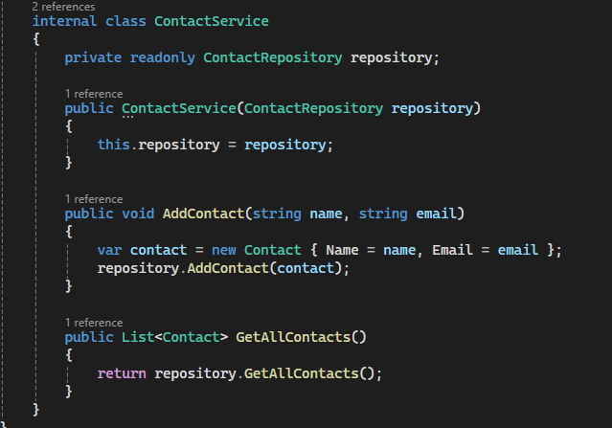
Business Logic Layer (BLL)
Async/await
Asynchronous programming

Slide 7
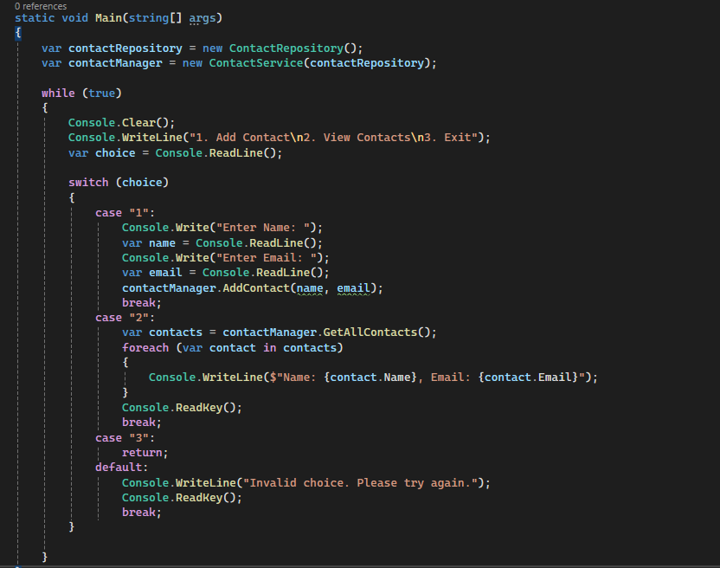
Presentation Layer
Async/await
Asynchronous programming

Slide 8
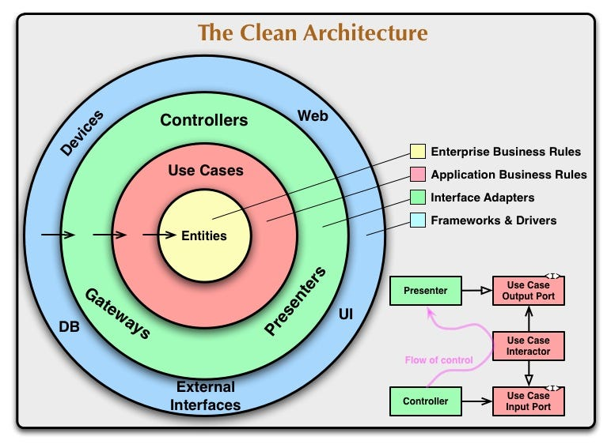
Clean Architecture
Async/await
Asynchronous programming
Clean Architecture principles, separating concerns into different layers and making it more maintainable and testable. The business logic is isolated in the Use Cases Layer, and the UI and database access are separated into their respective layers. This architecture allows for easier testing and future modifications without impacting other parts of the system. https://github.com/jasontaylordev/CleanArchitecture

Slide 9
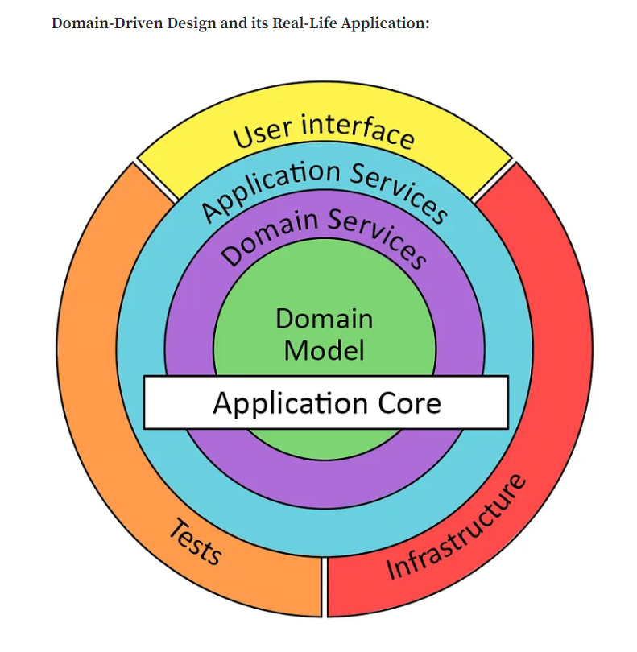
Domain-Driven Design (DDD)
Async/await
Asynchronous programming
Domain-Driven Design (DDD) is a software development approach that places the core focus on the domain or business problem being solved. It's a set of principles, patterns, and practices aimed at creating complex software systems that accurately represent real-world domains. https://github.com/ardalis/ddd-guestbook

Slide 10
DRY- Don't repeat yourself
Async/await
Asynchronous programming
DRY stands for "Don't Repeat Yourself," and it is a fundamental principle in software development and coding best practices. The DRY principle emphasizes the importance of minimizing redundancy in code by ensuring that each piece of knowledge or logic should exist in a single, unambiguous place within a software system. In other words, DRY encourages developers to avoid duplicating code, data, or concepts.

Slide 11
Async/await
Asynchronous programming
Useful information

